Slide 1
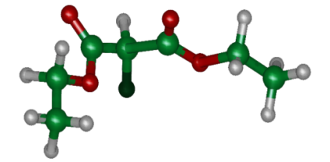




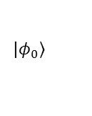

(a)
¹H
 |  | ¹H | ¹³C | ¹⁹F | T1 | T2
 | ¹H | 400 M |  |  | 2.8 | 1.2
 | ¹³C | 160.7 | 100 M |  | 2.9 | 1.1
 | ¹⁹F | 47.6 | -194.4 | 376 M | 3.1 | 1.3
¹³C
¹⁹F
(b)
(Laser Field)
(Kinetic)
(Potential)
$$|φ_{0}〉$$
$$V_{δt/2}$$
$$E_{δt/2}$$
$$QFT^{†}$$
$$T_{δt}$$
$$QFT$$
$$E_{δt/2}$$
$$V_{δt/2}$$
Loop 25 Times

